Slide 1
Keshav KV
Final Project
3/21/2024 Annual Review

Slide 2
PROJECT TITLE
Diabetes Prediction Machine Learning System using Support Vector Machine (SVM) Algorithm
3/21/2024 Annual Review

Slide 3


AGENDA
Introduction
Problem Statement
Project Overview
End Users
Solution Highlights
Modeling Approach
Results
Conclusion
3/21/2024 Annual Review

Slide 4

PROBLEM STATEMENT
Address the pressing need for early detection and proactive management of diabetes by developing a machine learning-based predictive system.
Utilize existing health data and machine learning algorithms such as SVM to accurately classify individuals as diabetic or non-diabetic based on their health parameters, thereby enabling timely interventions and improving health outcomes for at-risk populations.
3/21/2024 Annual Review

Slide 5

PROJECT OVERVIEW
Problem Identification: Recognize the challenge of timely detection and management of diabetes, a prevalent and potentially severe health condition worldwide.
Machine Learning Integration : Integrate machine learning techniques, particularly Support Vector Machines (SVM), to analyze historical health data and develop a predictive model capable of identifying individuals at risk of diabetes based on their health parameters.
3/21/2024 Annual Review

Slide 6

WHO ARE THE END USERS?
Individuals: People who are concerned about their health status or have a family history of diabetes may use your system to assess their risk and take proactive measures to prevent or manage the disease.
Healthcare Professionals: Doctors, nurses, and other healthcare providers can utilize your system as a tool for early detection and intervention, allowing them to offer personalized care and advice to patients at risk of diabetes.
Public Health Organizations: Organizations focused on public health initiatives may leverage your system to identify high-risk populations and develop targeted interventions, such as community outreach programs or health education campaigns, aimed at reducing the prevalence of diabetes and its associated complications.
3/21/2024 Annual Review

Slide 7

YOUR SOLUTION AND ITS VALUE PROPOSITION
Early Detection: By analyzing individuals' health parameters, your system can identify those at risk of diabetes at an early stage, enabling timely intervention and preventive measures. Early detection is crucial for effective management and reducing the risk of complications associated with diabetes.
Personalized Risk Assessment: Your system provides personalized risk assessment for each individual based on their unique health data. This tailored approach allows for targeted interventions and lifestyle modifications, optimizing the effectiveness of diabetes prevention strategies.
Empowerment Through Knowledge: By informing individuals about their risk of diabetes, your solution empowers them to make informed decisions about their health. It fosters proactive behavior, such as adopting healthier lifestyles, monitoring blood sugar levels, and seeking medical advice when necessary.
Support for Healthcare Professionals: Healthcare professionals can utilize your system as a decision support tool, aiding them in early diagnosis and personalized treatment planning for patients. It complements their expertise and enhances the quality of care provided to individuals at risk of or living with diabetes.
Public Health Impact: On a broader scale, your solution contributes to public health initiatives by identifying high-risk populations and guiding targeted interventions. By reducing the prevalence of diabetes and its associated health complications, it helps alleviate the burden on healthcare systems and improves overall population health.
3/21/2024 Annual Review

Slide 8

THE WOW IN YOUR SOLUTION
Precision Prediction: Your system goes beyond traditional risk assessment methods by harnessing the power of machine learning to deliver highly accurate and personalized predictions of diabetes risk. It analyzes a comprehensive set of health parameters to provide tailored insights for each individual, ensuring precision in identifying those at risk.
Real-Time Monitoring and Feedback: In addition to predicting diabetes risk, your solution offers real-time monitoring and feedback capabilities. Individuals can track changes in their health status over time, receive timely alerts about potential risk factors, and access personalized recommendations for preventive actions, all through an intuitive user interface.
Continuous Learning and Improvement: Through iterative machine learning algorithms, your system continuously learns from new data and updates its predictive models accordingly. This dynamic approach ensures that the system remains up-to-date with the latest medical knowledge and adapts to changes in individuals' health profiles
3/21/2024 Annual Review
8

Slide 9
MODELLING
Data Preparation:
Describe the initial step of data collection and preprocessing.
Mention that you used the "diabetes.csv" dataset, which contains various health parameters.
Highlight the importance of data cleaning, handling missing values, and ensuring data quality.
Model Selection:
Explain that you chose the Support Vector Machine (SVM) algorithm for modelling.
Briefly mention the characteristics of SVM, such as its effectiveness in handling high-dimensional data and its ability to find the optimal hyperplane for classification.
Training the Model:
Walk through the process of splitting the dataset into training and testing sets using the train_test_split function.
Explain how you trained the SVM classifier using the training data and evaluated its performance on both the training and testing sets.
Model Evaluation:
Discuss the accuracy scores obtained on both the training and testing data.
Emphasize the importance of assessing model performance on unseen data to ensure generalization and avoid overfitting.
Saving the Trained Model:
Explain the process of saving the trained model to disk using the pickle library.
Mention that the saved model can be later loaded and used for making predictions on new data without the need for retraining.
3/21/2024 Annual Review
9

Slide 10
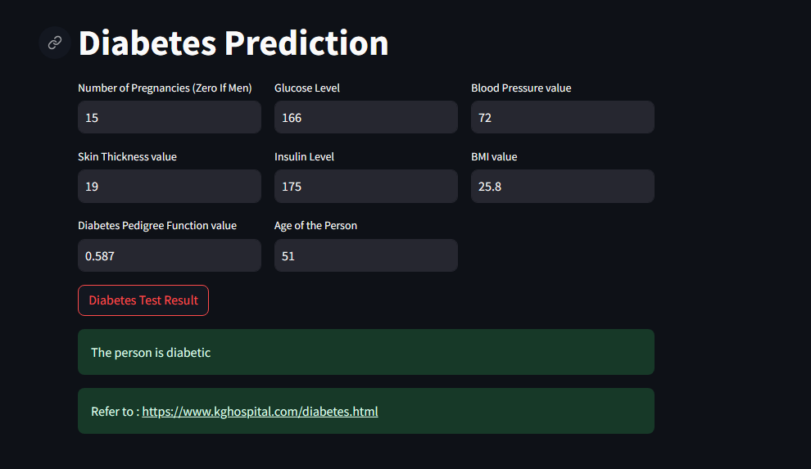
RESULTS
Demo Link
3/21/2024 Annual Review
10

